Slide 1



Improving clinician’s competence and confidence in integrating digital technology into assessment and treatment
Child and Adolescent Mental Health Service
14 March 2017

Slide 2
Professor Jane Burns
2016-17 Thinker in Residence

Slide 3

What the report found
The current system is
  poorly planned
  poorly integrated
  a "massive drain on people's wellbeing”
Has major deficiencies & a lack of support for people who are discharged from hospital after attempting suicide.

Slide 4
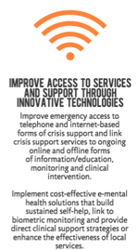
Recommendations

Slide 5

21st Century Mental Health
// Safe. Healthy. Resilient.
15 March, 2017
Notes:
I am talking about Australia’s single most valuable ASSET -
Please stand up if your family has been touched by the tragedy that is suicide or you have supported someone who lives with a mental illness – depression or anxiety, drug or alcohol addiction, an eating disorder or psychosis.
OK thanks – about XX% - you can sit down
Please stand up if you work or study with someone or have a friend who lives with a mental illness.
OK thanks – about XX% - you can sit down
Please stand up if you live with a mental illness……
Despite services like beyondblue, Movember, Lifeline the stigma associated with mental illness means that despite 50% of Australians affected by poor mental health less than 30% of people will seek help. For men this can take up to 15 years!!!!!
Today I want to share with you a little bit about my twenty years dedicated to suicide prevention, and both the joy and the messiness of life.

Slide 6
2015: What the report found
The current system is
  poorly planned
  poorly integrated
  a "massive drain on people's wellbeing”
Has major deficiencies & a lack of support for people who are discharged from hospital after attempting suicide.

Slide 7
Recommendations

Slide 8
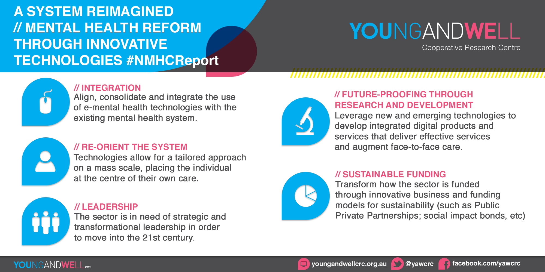
NATIONAL MENTAL HEALTH COMMISSION
OUR RECOMMENDATIONS ON TECHNOLOGY
8

Slide 9
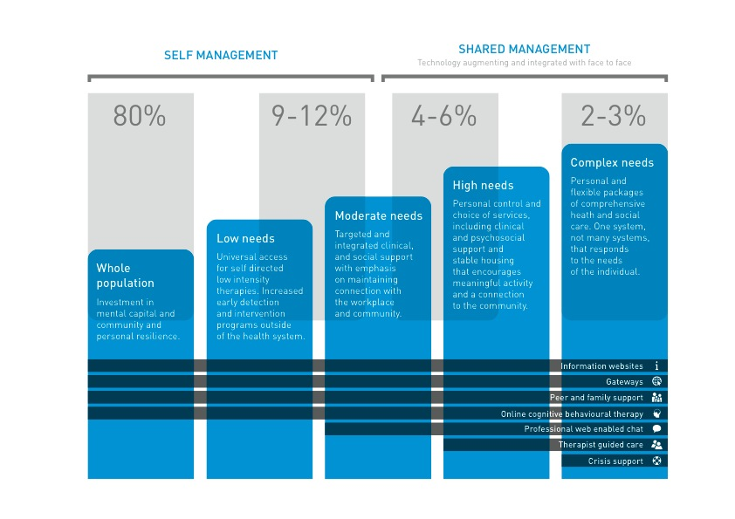
Policy imperative - right care at the right time in the right way
Burns, 2015

Slide 10
Ten challenges facing service providers …
‘UBERisation’ of health care – how to respond to disruptive innovation in mental health – e.g. eMentalhealth & community awareness
Uncertainty in government expectations & need for policy clarity – ‘low intensity services’, ‘packaged care’, ‘stepped care’ etc
Capability for collaboration & to facilitate co-design
Flexibility & agility to respond to opportunity & regional/local planning
Getting to meaningful & effective change – transition pain
Capacity, investment for development vs. service delivery
Empowering those with Lived Experience
Understanding ‘Stepped care’ or clinical staging
Suicide & Suicide Prevention – lack of data, lack of expertise, Aboriginal & Torres Strait Islander suicide
Moving from a focus on outputs to outcomes & results based payment

Slide 11
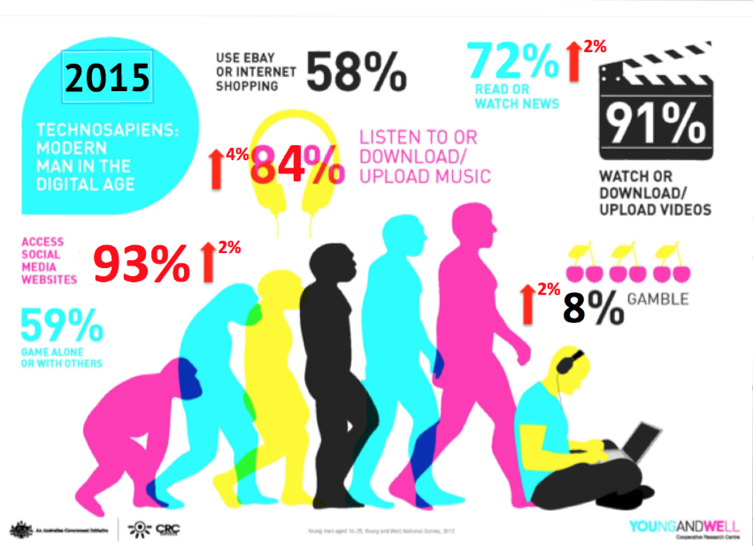

Slide 12
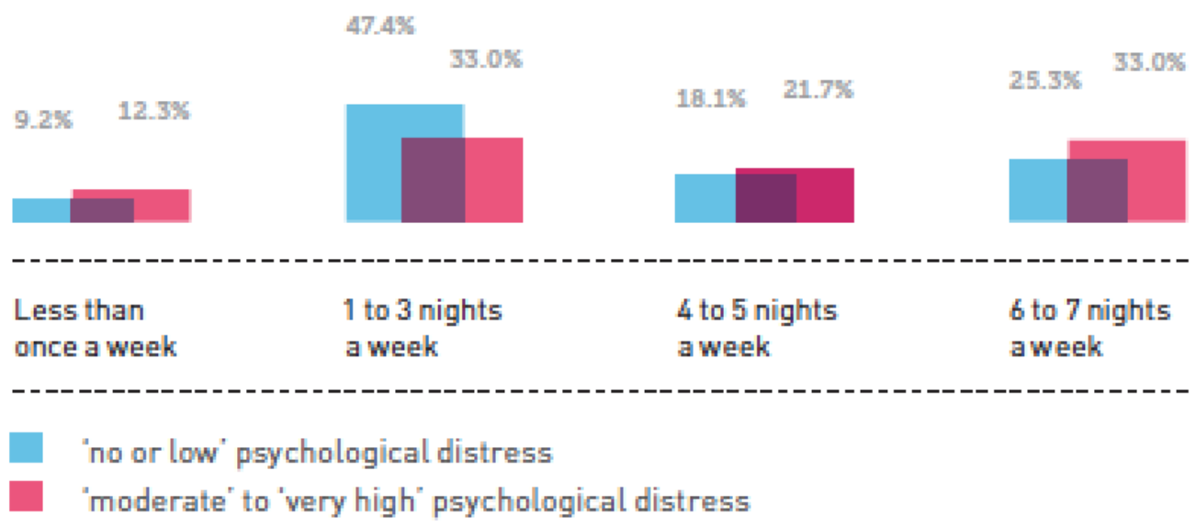
‘GAME ON’
Frequency of internet use after 11:00pm
“33% of young
men experiencing
‘moderate’ to ‘very high’ psychological distress are online six to seven nights a week after 11.00pm."
Burns et al., 2013
15/03/2017
12

Slide 13
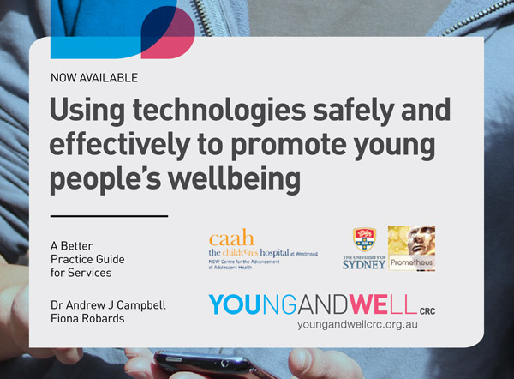
INTRODUCING THE BETTER PRACTICE GUIDE

Slide 14
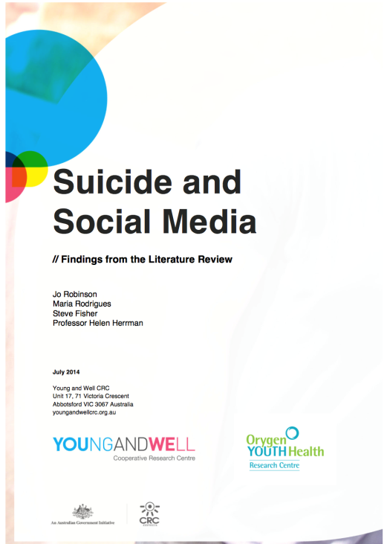
The role of social media in suicide
http://www.youngandwellcrc.org.au/wp-content/uploads/2014/07/Robinson_2014_Suicide-and-Social-Media_Findings-from-the-Literature-Review.pdf

Slide 15









Slide 21



Slide 23

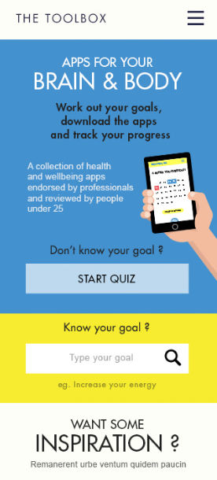
THE TOOLBOX
Notes:
The Toolbox - http://au.reachout.com/sites/thetoolbox
ReachOut

Slide 24

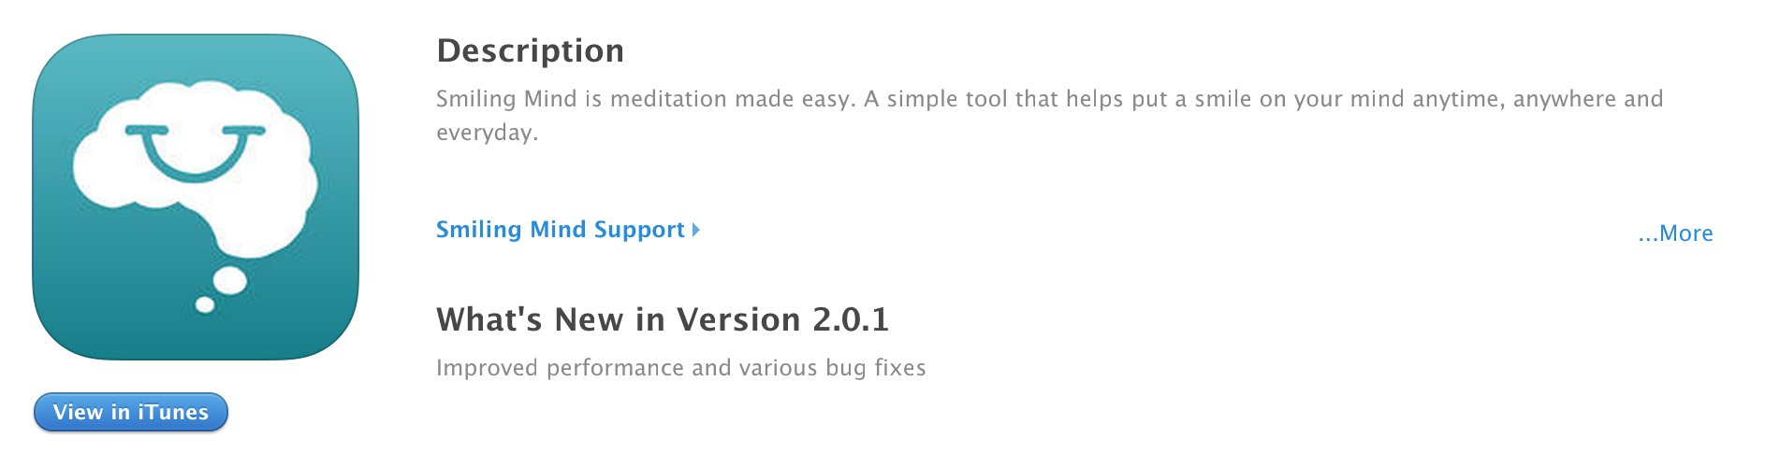
SMILING MIND
Notes:
send Paul some links which explains the science behind mindfulness from Headspace and Smiling Mind
show Paul a youtube video from Headspace or Smiling Mind which explains the concept of Mindfulness
a blog that discusses research showing MRI scans show that after 8-weeks, the brain’s “fight or flight” center, the amygdala, appears to shrivel. This part of the brain, associated with fear and emotion, is involved in the initiation of the body’s response to stress. As the amygdala shrinks, the pre-frontal cortex – associated with higher order brain functions such as awareness, concentration and decision-making – becomes thicker.

Slide 25
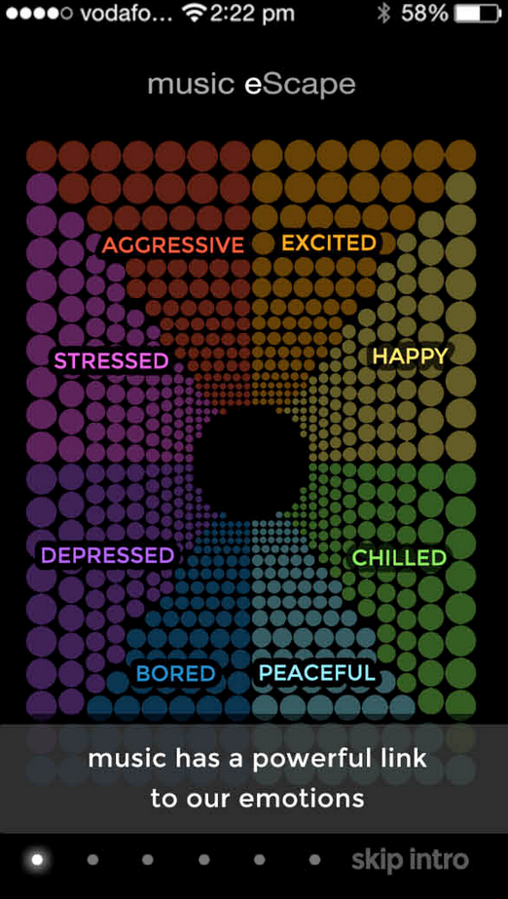
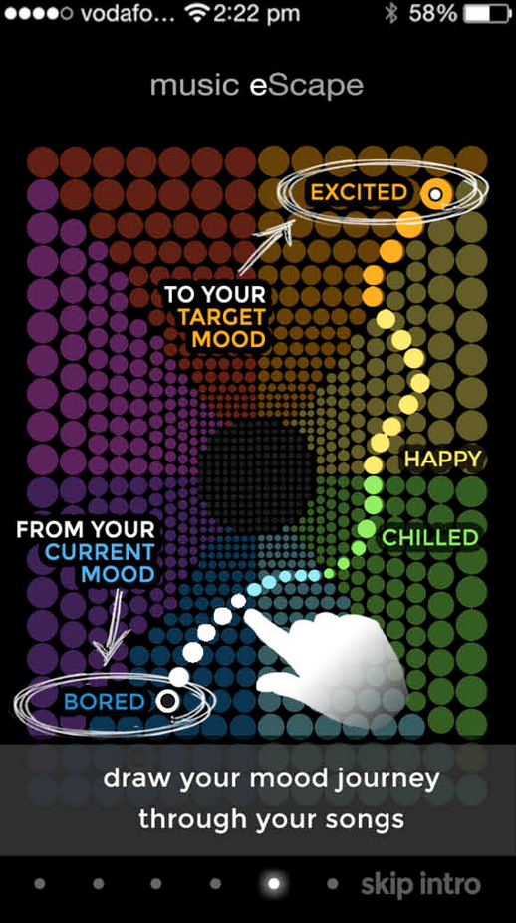
music eScape

Slide 26
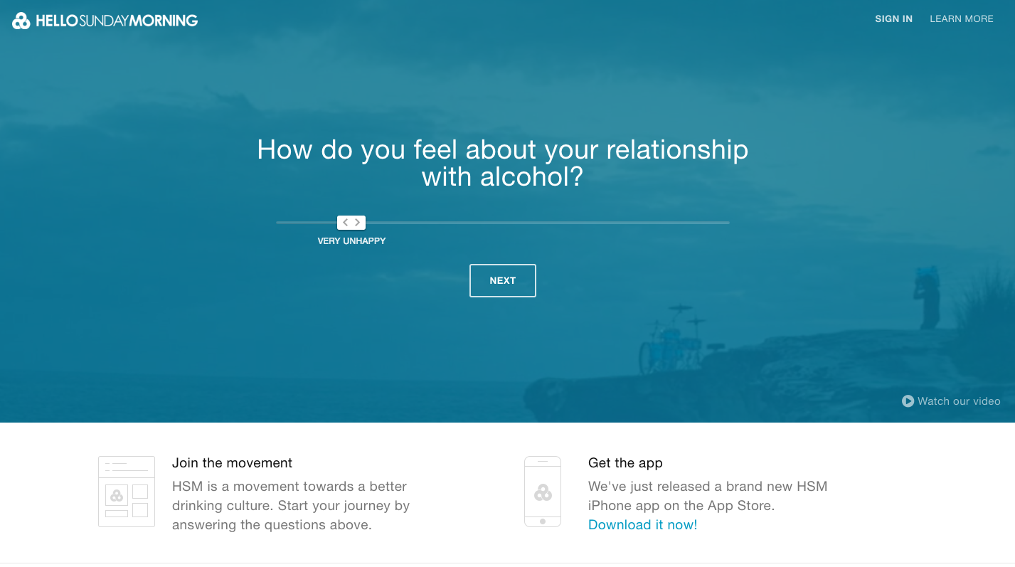
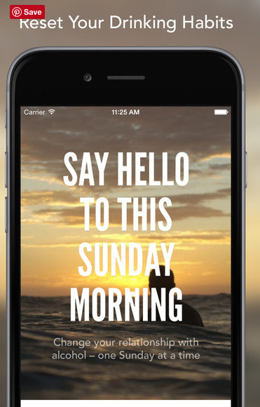
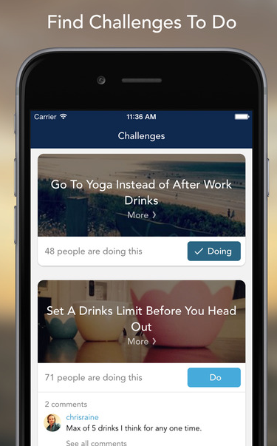
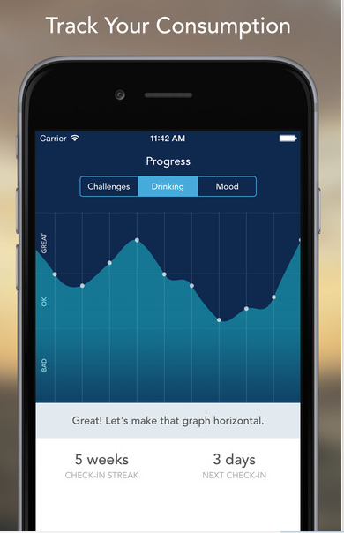

Slide 27

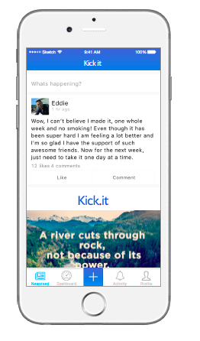


Slide 28
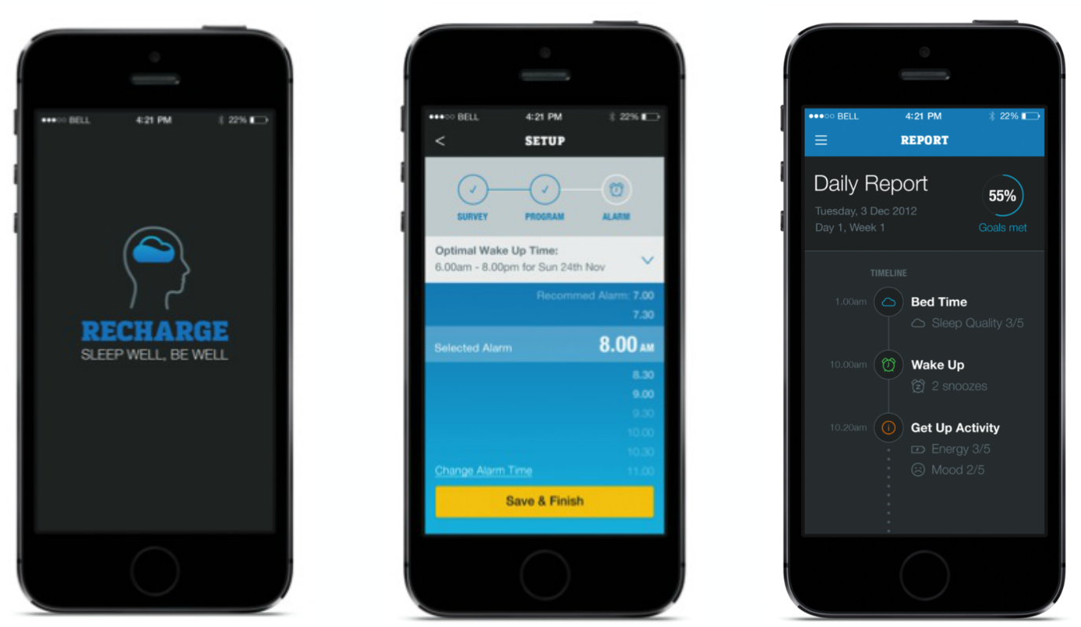
// RECHARGE: SLEEP WELL, BE WELL
A free mobile phone app designed to improve young men’s wellbeing by helping regulate the sleep/wake cycle through a six week program.
15/03/2017
28
Notes:
Recharge focuses on FOUR KEY AREAS:
A regular wake and sleep time each day, achieved gradually over six weeks
An alarm clock that triggers fun activities designed to get you up and out of bed
Increasing exposure to daylight early in the day, to help reset the body clock
Encouraging increased physical activity, especially within two hours of waking up.

Slide 30
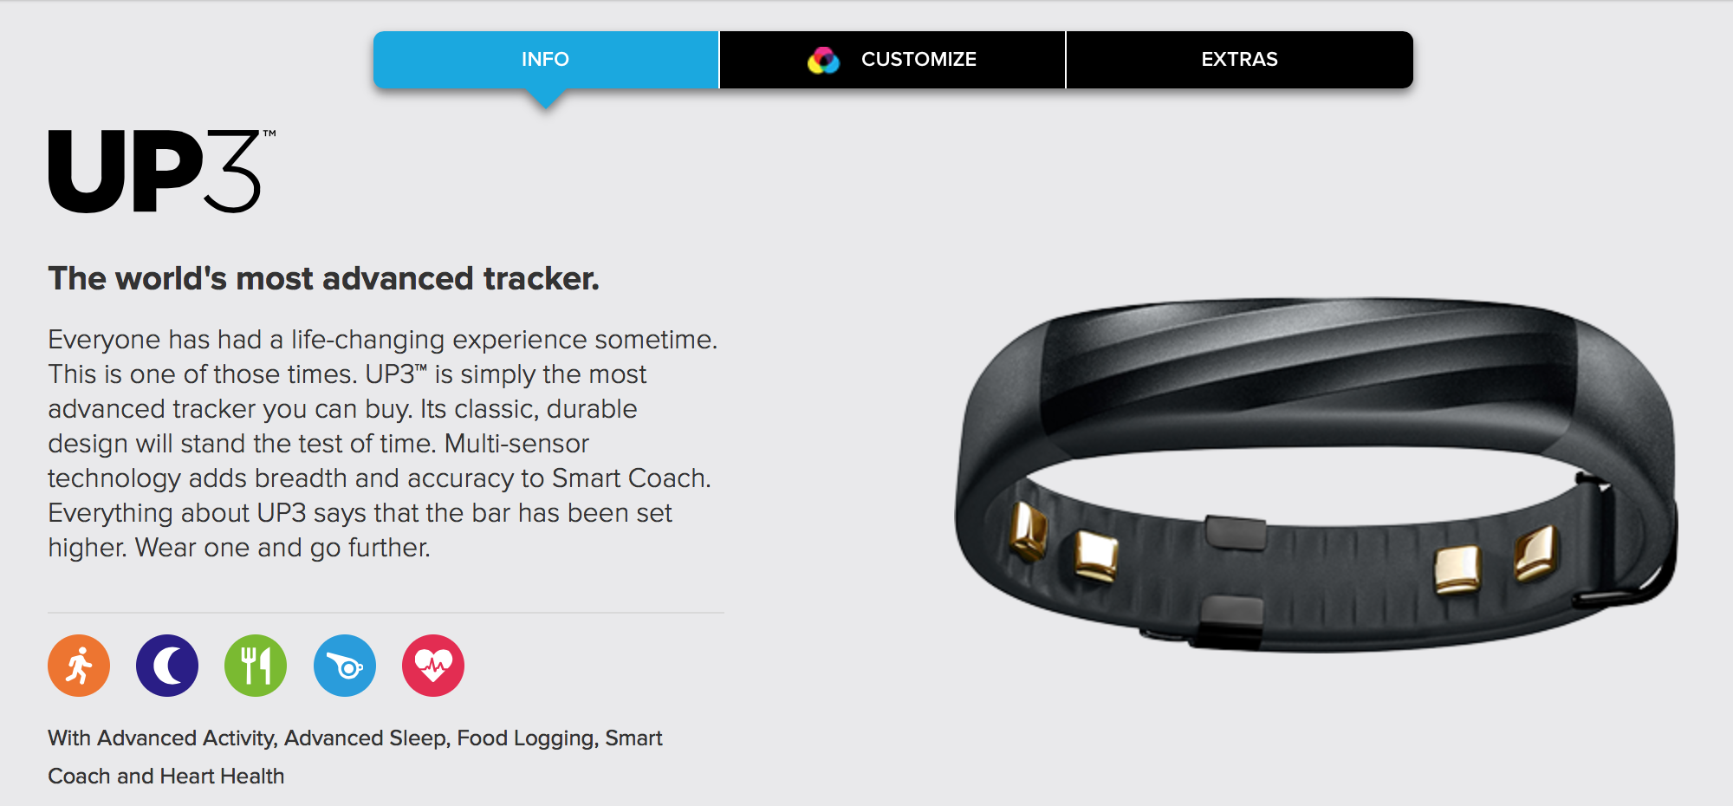

Slide 31




E-MENTAL
LINK
1A
ONLINE
HEALTH
1B
HC
CLINICAL CARE
upgraded support
CLINIC
2
FACE TO FACE
ASSESSMENT
3
SELF IDENTIFIED
E-MENTAL HEALTH CLINIC
CLINICAL STAGING – STEPPED CARE

Slide 32

CHALLENGES IN SERVICE DELIVERY
// Research Questions
HELP SEEKING // Why don’t young people seek help? Is user driven screening appropriate? What does online triage look like?
CONSUMER ENGAGEMENT// Can young people be partners in care? What would an empowered consumer manage online?
COMPLIANCE TO TREATMENT// Are social networking, gaming, digital content creation, mobile applications and virtual worlds a valid and reliable tool to enhance compliance?
WORKFORCE CAPACITY// What role can technology play in rural, remote and regional communities and in vulnerable populations? How do you up skill a workforce in the use of ICT?
“It was 1.30am; I was desperate and had nowhere to turn. I somewhat sarcastically went to Google and typed in ‘help’. The Reach Out site was the first result.”
15/03/2017
32

Slide 33
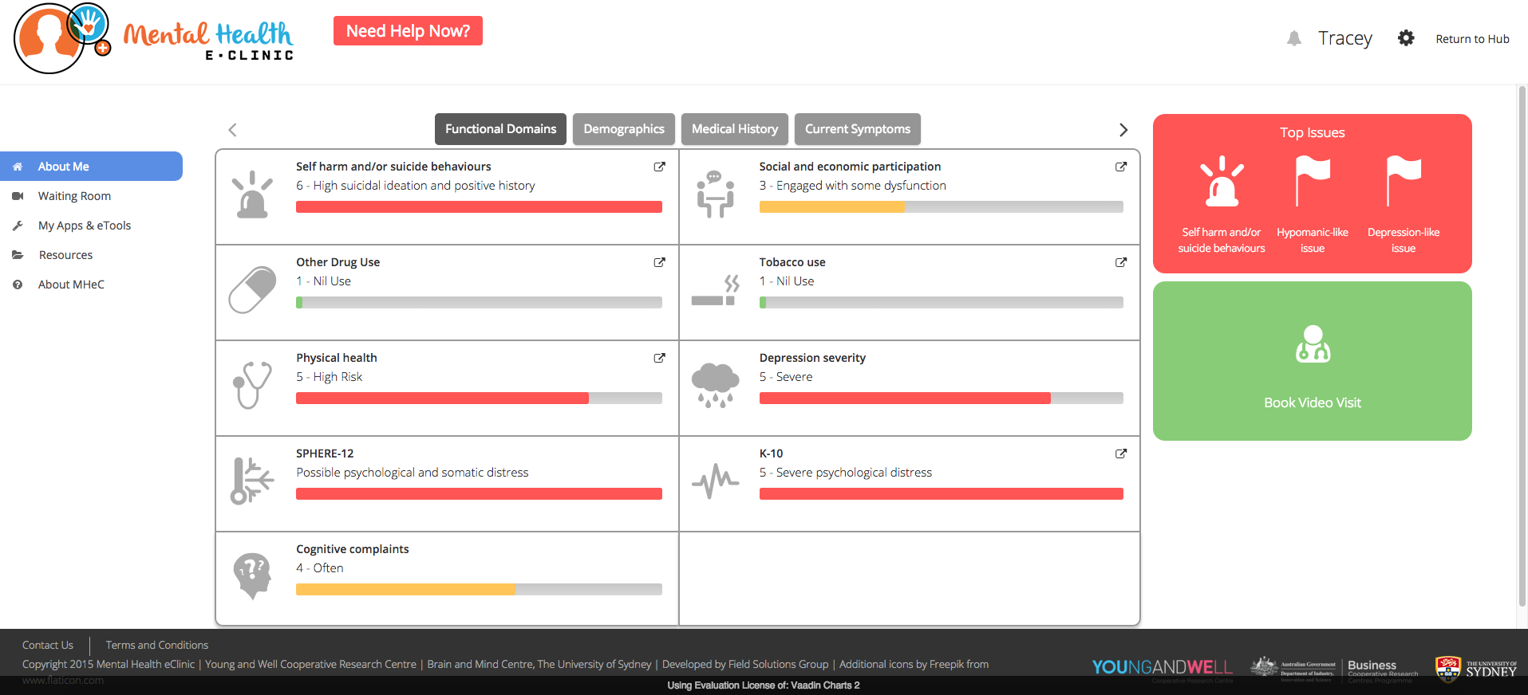

Slide 34
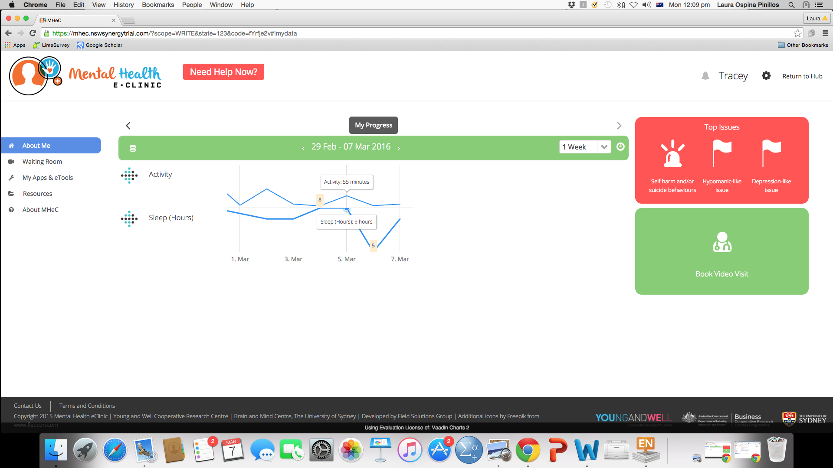

Slide 35










Slide 36

Thank you to our partners

Slide 37
Let us know what you think
Find out more
Website www.ccyp.wa.gov.au
Twitter @CCYPWA #CCYPThinker
Please complete a feedback form or email info@ccyp.wa.gov.au

